Slide 1


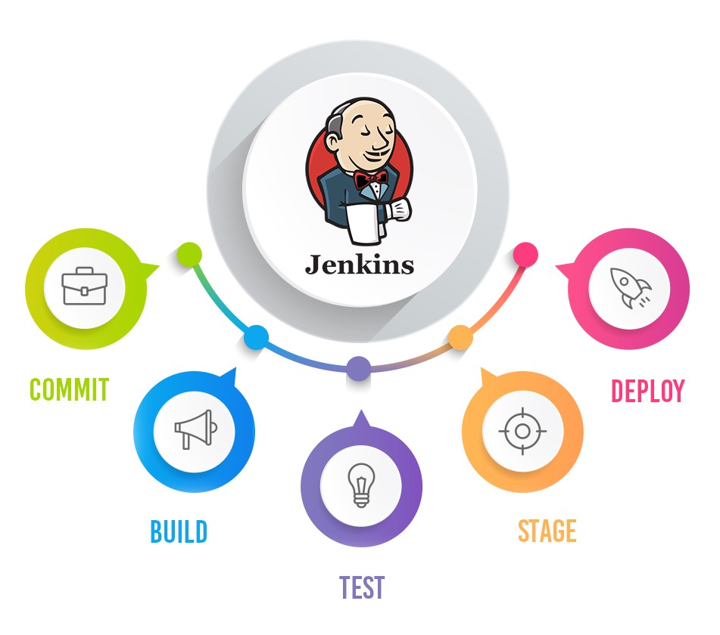
Jenkins Mastery for Software Tester
Pramod Dutta
Running Jenkins in Docker

Slide 2
Agenda
Install Jenkins with Docker
Running a Maven Project Selenium Hello World
Understand FreeStyle Job

Slide 3
Install Jenkins
https://docs.docker.com/get-docker/
Run the Docker Command
docker pull jenkins/jenkins
docker run -p 8080:8080 -p 50000:50000 -v /your/home:/var/jenkins_home jenkins

Slide 4
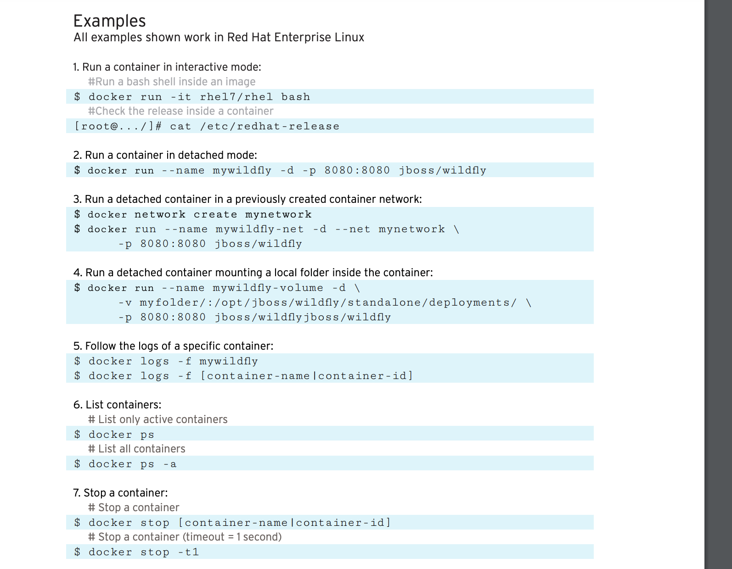
Docker Commands
https://design.jboss.org/redhatdeveloper/marketing/docker_cheatsheet/cheatsheet/images/docker_cheatsheet_r3v2.pdf

Slide 5
Docker Commands
docker run -p 8080:8080 --name=jenkins-master -v /Users/pramod/Documents/jenkinsdemo/jenkinsdocker:/var/jenkins_home -d jenkins/jenkins
To See the logs
docker ps
docker logs -f 72d5c909f166
https://hub.docker.com/_/jenkins

Slide 6
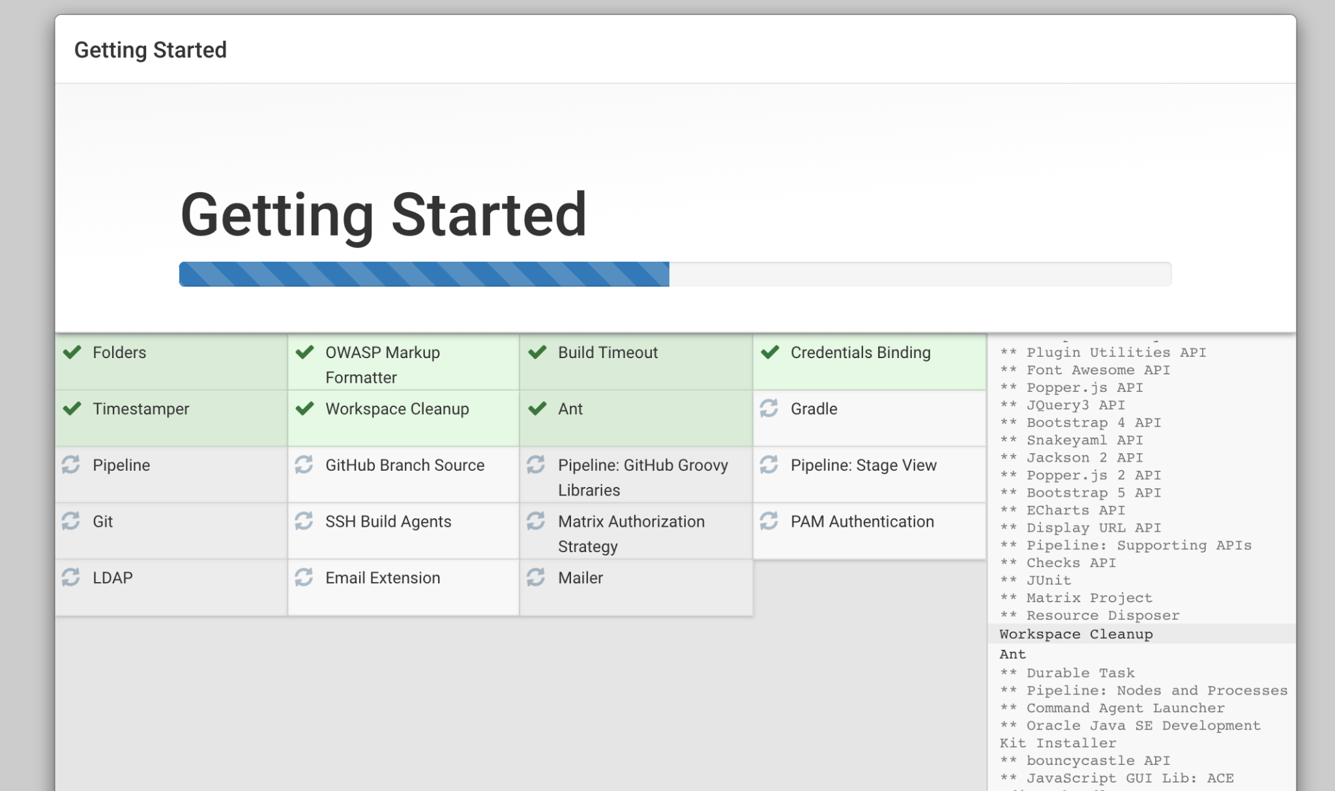
Docker Commands
docker run -p 8080:8080 --name=jenkins-master -v /Users/pramod/Documents/jenkinsdemo/jenkinsdocker:/var/jenkins_home -d jenkins/jenkins
To See the logs
docker ps
docker logs -f 72d5c909f166
https://hub.docker.com/_/jenkins

Slide 7
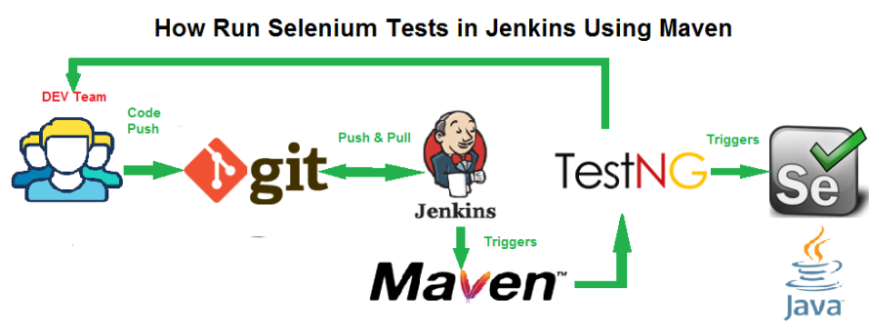
Run Selenium Test on Jenkins

Slide 8
Running FreeStyle Job
Create the FreeStyle job
Add Maven Plugin
Run the Command

Slide 9

Lets See Jenkins Job Demo
Demo Jenkins job

